Slide 1

Edit the one that’s on OneDrive
Not this one

Slide 2


Introduction
Edit the one that’s on OneDrive
Image and video analysis software must use computer vision techniques to identify times shown on analog clocks
Modern implementations of image analysis use complicated computer learning/artificial-intelligence techniques
Classical computer vision techniques can be used to simplify process
10:10

Slide 3
Theory
Identify and Isolate
Identify and isolate analog clocks from input image
Pre-Processing
Blur pertinent regions to remove noise/unnecessary clock features
Edge Detection
Perform edge detection
Line Detection
Perform line detection of edge map, compare line lengths to determine minute/hour hand
Classification
Determine hour and minute from gradient direction/detected line angles
Edit the one that’s on OneDrive

Slide 4
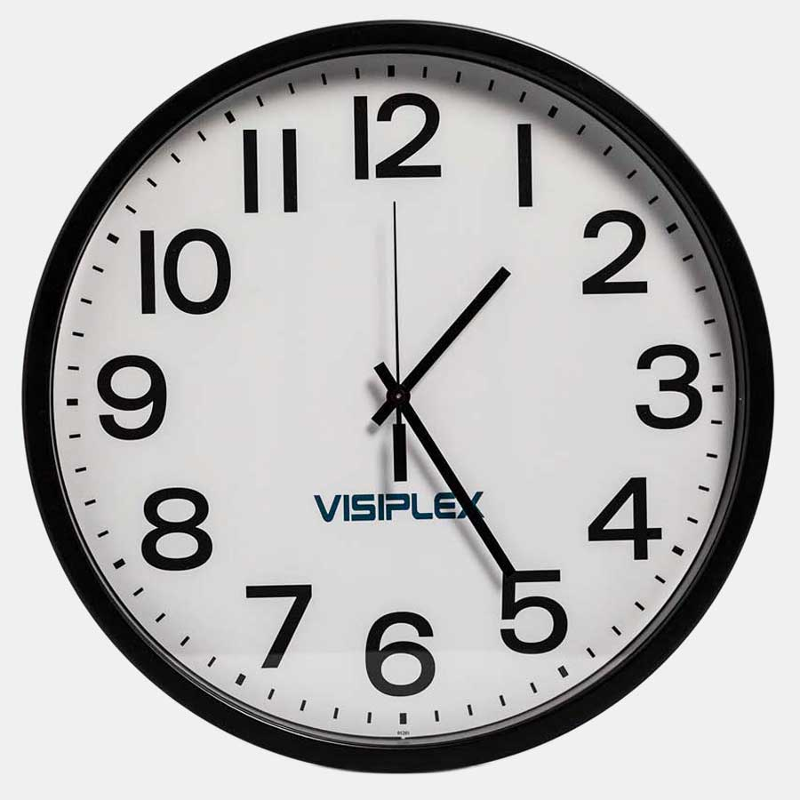
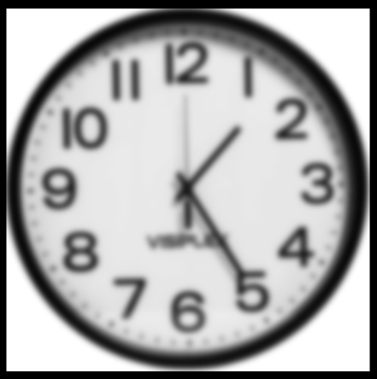
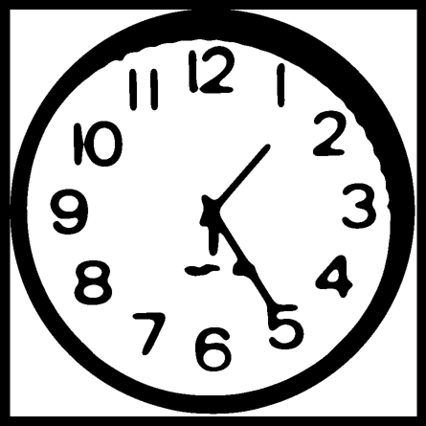
Pre-Processing
Edit the one that’s on OneDrive
Provided image matrix of interest region, some clock faces have branding/writing which must be ignored
Second hand on some clocks may be same length as minute hand; only distinguishable by watching clock in real-time. Try to remove second hand using strong Gaussian blur.
Gaussian smoothing can remove unnecessary features, making edge and line detection easier

Slide 5
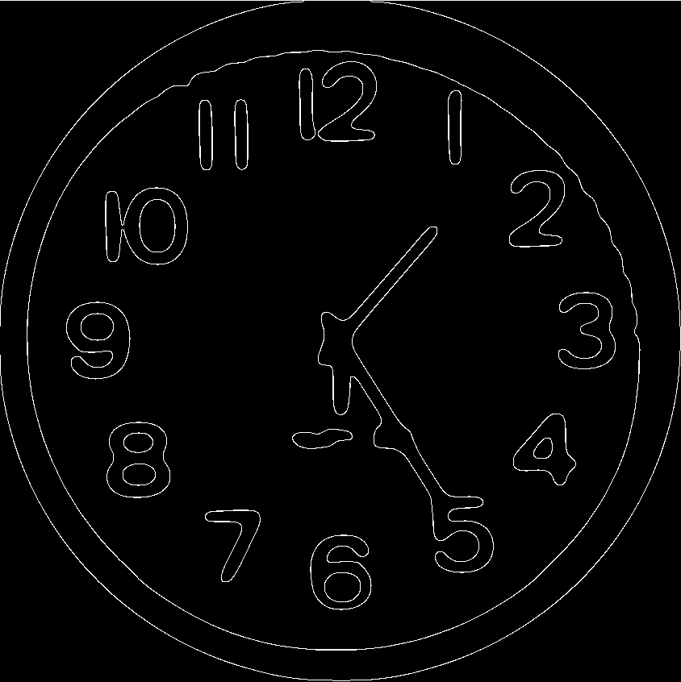
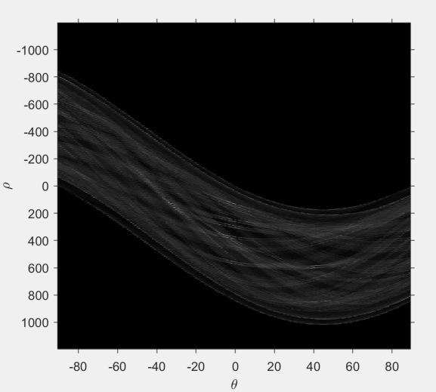
Edge and Line Detection
Edit the one that’s on OneDrive
Provided binary input image, edges must be detected so that line section can take place.
Canny Edge Detector used with threshold = 0.5
Hough Transform performed on edge map from Canny Edge Detector

Slide 6
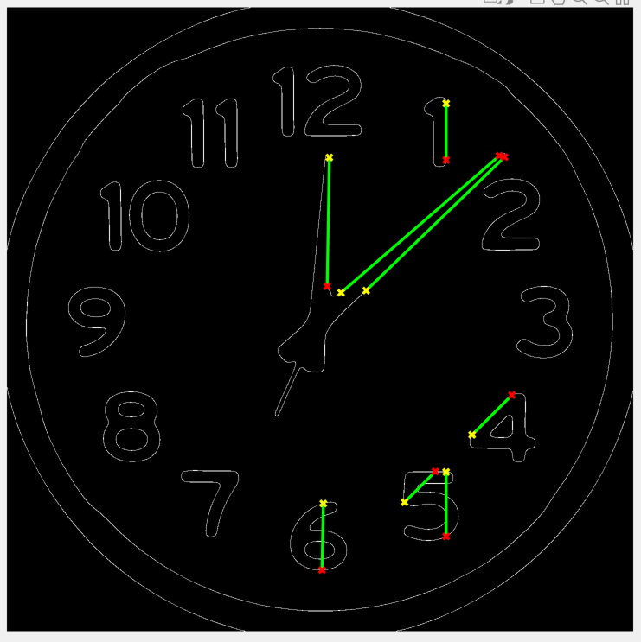
Hough Transform
Edit the one that’s on OneDrive
Hough Transform will identify lines from hour/minute hands, as well as other not-important lines
Hough parameters needed to be hand-tuned
Number of peaks = 5
Minimum Line Length = 100
Hough Threshold = 1% of H max

Slide 7
Edit the one that’s on OneDrive

